Slide 1
Project Design Phase-I
Solution Architecture
Date | 25 October 2022
Team ID | PNT2022TMID52366
Project Name | Project - Deep Learning Fundus Image Analysis for Early Detection of Diabetic Retinopathy
Maximum Marks | 4 Marks

Slide 2
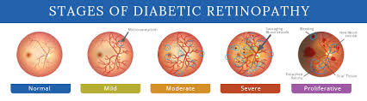
Labels of the dataset:
Normal
mild
moderate
severe
PDR

Slide 3
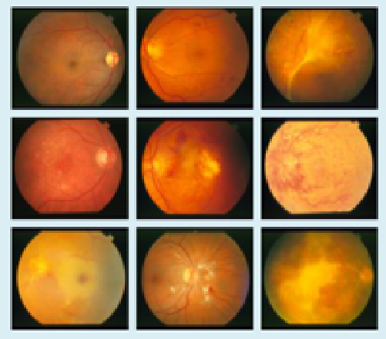
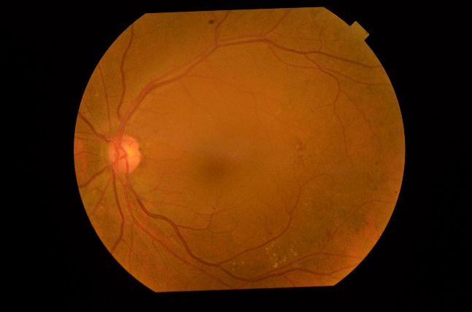
Output
(Label of the test input image)
CNN Architecture
Data Pre-processing
Data augmentation
Input image

Slide 4
Normal
mild
- -
moderate
severe
PDR
Convolution + ReLu layer
Pooling layer
Input image
Convolution + ReLu layer
Pooling layer
Flatten
Softmax
Output
Fully connected layer

